Slide 1

Web Application Penetration Testing
Perform a penetration test on a vulnerable web application (e.g., DVWA or OWASP Juice Shop) using the OWASP Top 10 framework. Discover and exploit common web vulnerabilities and provide remediation guidance.
By:
Rupsa Koley
Ravi Prakash

Slide 2
Sql Injection (admin login)
SQL injection is a common vulnerability where an attacker injects malicious SQL code into the SQL query running on the server-side.
SQL query running on the server side takes the client’s input as a parameter, an attacker can modify the query in a way that exposes, modify, or destroy the data in the database.
The Juice shop is not properly validating user inputs. so this gives the possibility of SQL injection attack.
Step 1: First, we need to go to the login.

Slide 3
Step 2: Then for our payload we will input in email = ‘ OR ‘1’ = ‘1’ – and password = any
Let’s break down the payload:
'
Closes the opening quote in the SQL query, escaping the intended string context.
OR '1' = '1'
This condition is always true. The OR operator ensures that if either the original condition or this one is true, the entire WHERE clause evaluates to true.
--
This is a SQL comment. It tells the database to ignore everything that comes after it, effectively bypassing the password check.

Slide 4
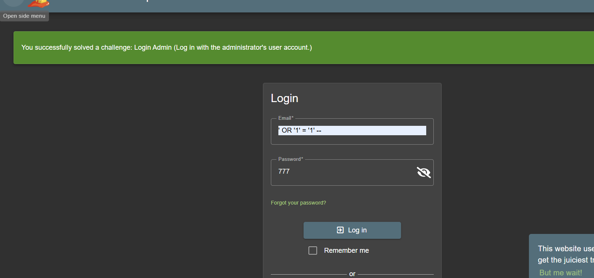

Slide 5
Impact:
Data theft or deletion from DB
Remote Code Execution (RCE)
Mitigation:
Use prepared statements / ORM
Validate and sanitize inputs

Slide 6
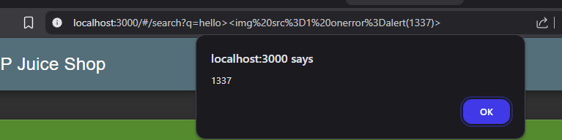
XSS (cross - site - scripting)
Cross-site scripting (XSS) is a security vulnerability in web applications that allows attackers to inject malicious client-side scripts (typically JavaScript) into web pages viewed by other users.
Step 1: In the search we need to type hello><img src=1 onerror=alert(1337)>
Step 2. We got our xss exploited we can see the audio track which should not be shown there.

Slide 7
Impact:
Session hijacking, account takeover
Defacement or phishing attacks
Mitigation:
Encode/escape user input before rendering

Slide 8
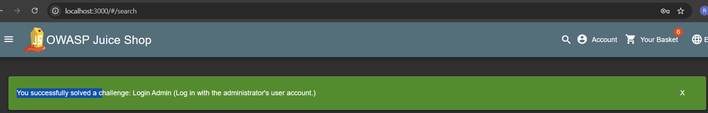
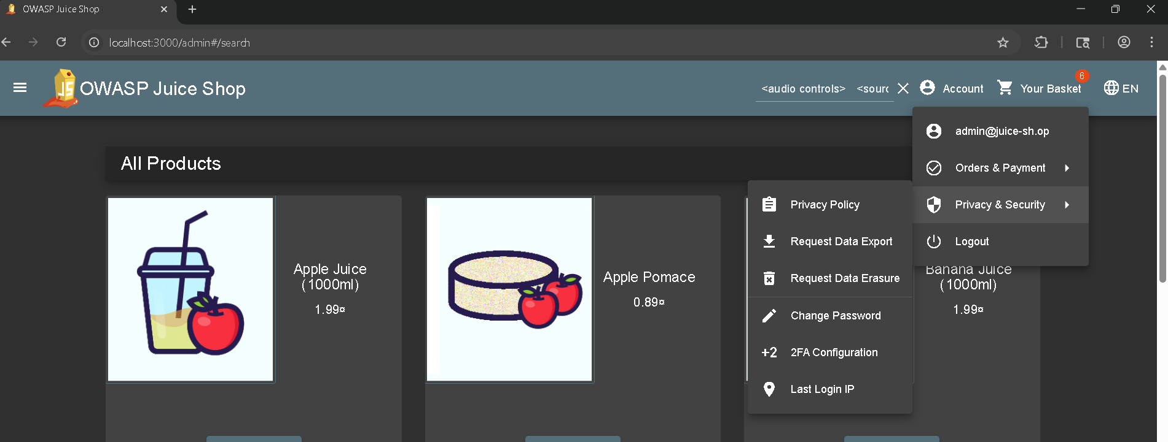
Step 3: Now we have admin access

Slide 9
Set up the test environment (Juice Shop)
1. Install Node.js (if not installed)
sudo apt update
sudo apt install -y curl git
curl -fsSL https://deb.nodesource.com/setup_20.x | sudo -E bash -
sudo apt install -y nodejs
2. Download Juice Shop
git clone https://github.com/juice-shop/juice-shop.git
cd juice-shop
3. Install Dependencies:
npm install
4. Start Juice Shop:
npm start
5. Now open:
http://localhost:3000

Slide 10
Insecure Direct Object References (IDOR)
What it is: Users can access resources or perform actions without proper authorization.
Access other users’ baskets by changing:
http://localhost:3000/#/basket/1 --> http://localhost:3000/#/basket/2
Steps to Reproduce:
add the product to basket and intercept the req. in burp suite
Send the req. to repeater
Modify the req.
GET /rest/basket/1 → GET /rest/basket/2
Observe the response,you can access other’s bucket by just change the id.

Slide 11
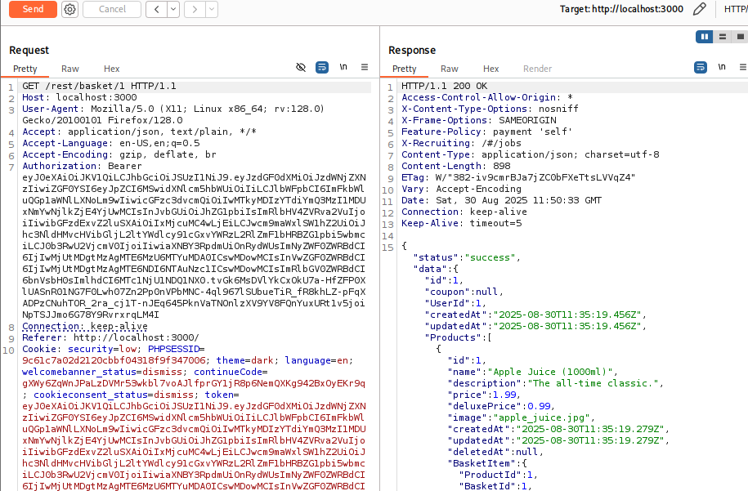
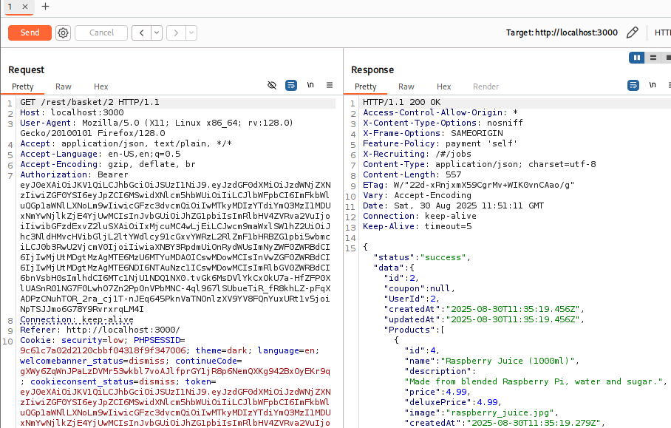
→

Slide 12
Impact:
Unauthorized access to sensitive data
Privilege escalation (normal user → admin)
Mitigation:
Enforce strict server-side access checks
Use indirect references (UUIDs instead of IDs)

Slide 13
Broken Access Control
Any logged-in (or sometimes unauthenticated) user can directly access it by browsing to the URL.
Direct access into admin panel
http://localhost:3000/#/ → http://localhost:3000/#/administration
Normal user can access → Broken Access Control.
Steps to reproduce:
Login as a normal user or sometimes no login
Manually enter or modify the url:
http://localhost:3000/#/ → http://localhost:3000/#/administration
Observer that you can access the admin panel without authentication

Slide 14
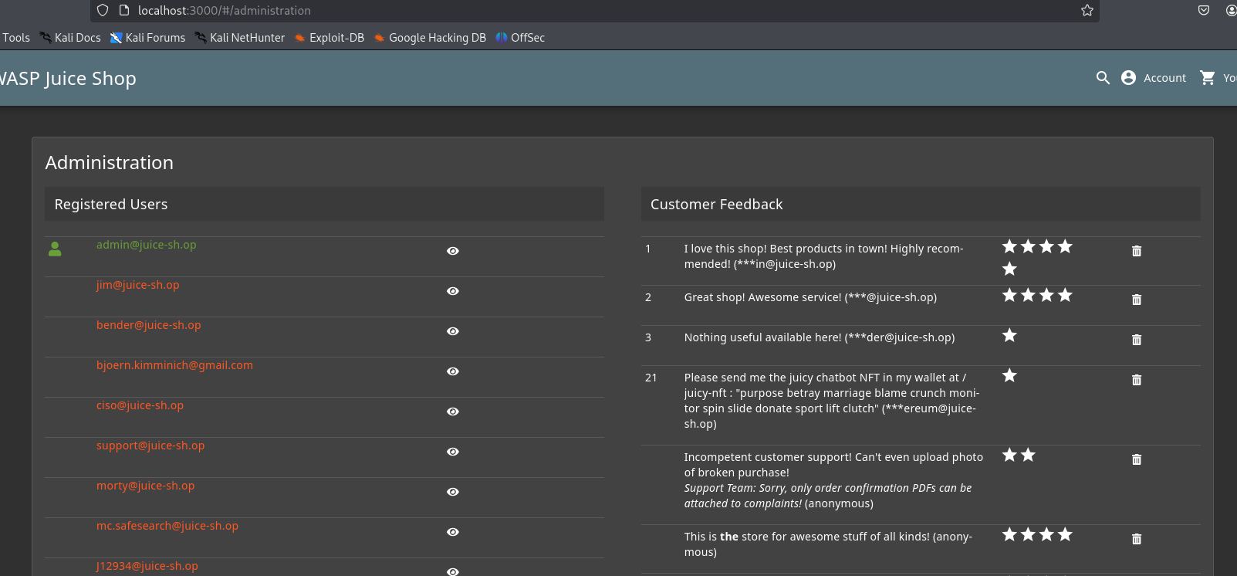

Slide 15
Impact
Unauthorized access to admin functions.
Potential exposure of sensitive data (user accounts, logs).
Mitigation
Enforce role-based access control (RBAC).
Restrict sensitive routes (/administration) to admin-only roles.
Hide admin links from UI.

Slide 16
Security Misconfigurations
Vulnerability: Directory Listing with Sensitive files
The web server is misconfigured and allows directory listing
Attackers can browse folders and directly access files (like backups, configs, or source code).
Step to reproduce
In browser, go to “ http://localhost:3000/ftp “
Observe server response instead of showing a 403 Forbidden movie direct the server displays a list of files
Or we can easily download the sensitive files(.bak).

Slide 17
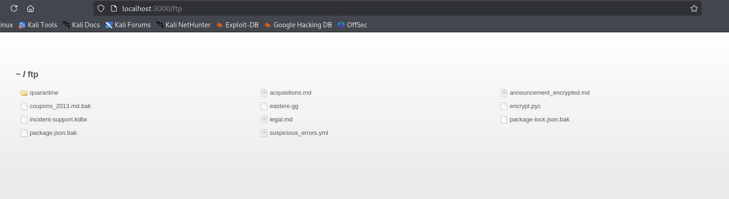

Slide 18
Impact:
Exposure of sensitive files/configs
Easier exploitation by attackers
Mitigation:
Disable directory listing, remove default accounts
Apply security hardening & patch regularly

